Slide 1
COMP3013 Tutorial01 Exercise Solution
2025 Fall

Slide 2
Exercises
To write a good query, you need to pay attention to three things.
  Which table is used?
  What is the predicate?
  What are the attributes in the result?
Find the information of actors whose first name is Russell.
Find the information of actors whose first name is Russell and last name is Close.
Find the email of customers whose first name is Harry and active is 0.
Find the full name of the actor whose id is 99.
Find the title and special features of the films whose replacement cost is lower than 20 and rental rate is higher than 4.0.
Find the customer id of the customers who have made a payment on 2005-05-25 but the amount does not exceed 3.
Notes:
6. select distinct customer_id from payment where payment_date BETWEEN '2005-05-25' and '2005-05-26' and amount <= 3

Slide 3
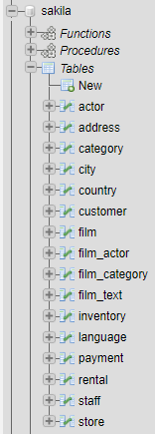
sakila tables

Slide 4
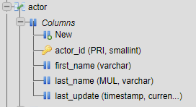
1. Find the information of actors whose first name is Russell.
SELECT * FROM ACTOR WHERE FIRST_NAME='RUSSELL'.

Slide 5
2. Find the information of actors whose first name is Russell and last name is Close
SELECT * FROM ACTOR
WHERE
FIRST_NAME='RUSSELL'
AND
LAST_NAME='CLOSE'

Slide 6
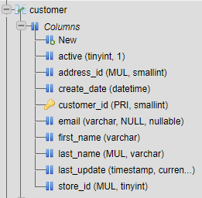

3. Find the email of customers whose first name is Harry and active is 0.
SELECT EMAIL FROM CUSTOMER
WHERE
FIRST_NAME='HARRY'
AND
ACTIVE=0

Slide 7

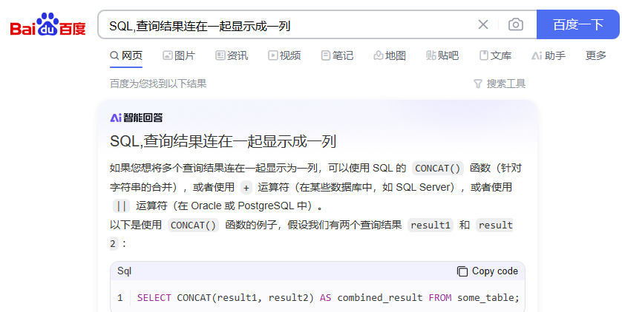

4. Find the full name of the actor whose id is 99.
SELECT FIRST_NAME, LAST_NAME
FROM ACTOR
WHERE ACTOR_ID=99
SELECT CONCAT(FIRST_NAME, ' ', LAST_NAME) AS 'FULL NAME'
FROM ACTOR
WHERE ACTOR_ID=99

Slide 8
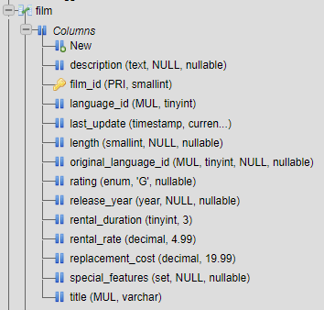
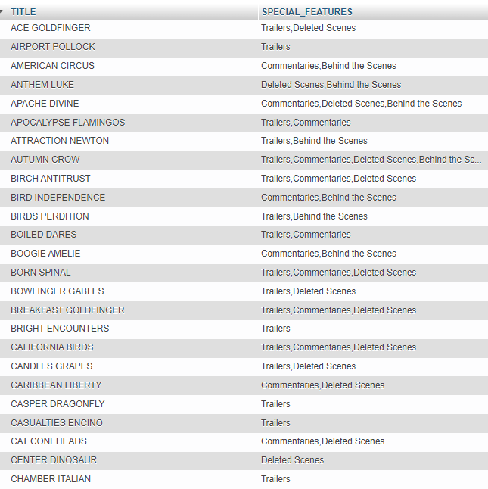
5. Find the title and special features of the films whose replacement cost is lower than 20 and rental rate is higher than 4.0.
SELECT TITLE, SPECIAL_FEATURES
FROM FILM
WHERE
REPLACEMENT_COST<20
AND
RENTAL_RATE>4.0

Slide 9
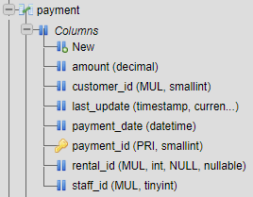
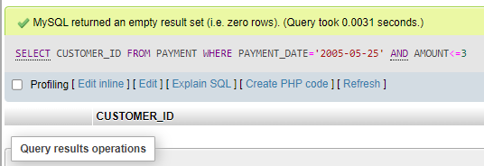
6. Find the customer id of the customers who have made a payment on 2005-05-25 but the amount does not exceed 3.
SELECT CUSTOMER_ID
FROM PAYMENT
WHERE
PAYMENT_DATE='2005-05-25'
AND
AMOUNT<=3
Why?

Slide 10
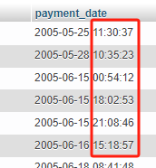
6. Find the customer id of the customers who have made a payment on 2005-05-25 but the amount does not exceed 3.
SELECT CUSTOMER_ID
FROM PAYMENT
WHERE
PAYMENT_DATE='2005-05-25'
AND
AMOUNT<=3
SELECT PAYMENT_DATE
FROM PAYMENT
Why?
The data in payment_date includes
not only the date but also the payment time,
we need to use time range to select out the
result

Slide 11
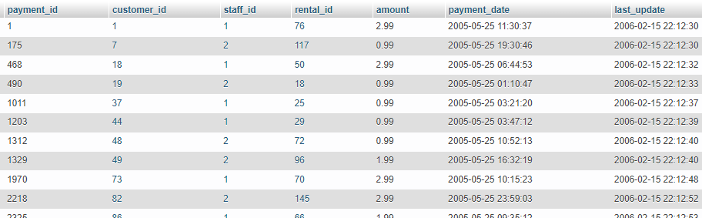
6. Find the customer id of the customers who have made a payment on 2005-05-25 but the amount does not exceed 3.
SELECT *
FROM PAYMENT
WHERE
PAYMENT_DATE
BETWEEN '2005-05-25' AND '2005-05-26'
AND
AMOUNT<=3

Slide 12
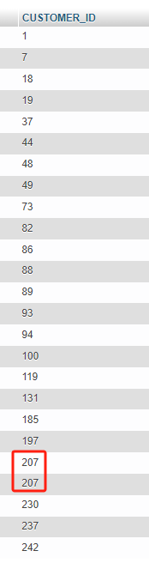
6. Find the customer id of the customers who have made a payment on 2005-05-25 but the amount does not exceed 3.
SELECT CUSTOMER_ID
FROM PAYMENT
WHERE
PAYMENT_DATE
BETWEEN '2005-05-25' AND '2005-05-26'
AND
AMOUNT<=3

Slide 13
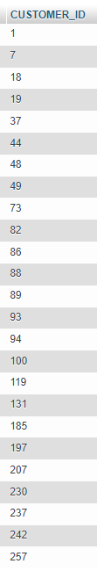
6. Find the customer id of the customers who have made a payment on 2005-05-25 but the amount does not exceed 3.
SELECT DISTINCT CUSTOMER_ID
FROM PAYMENT
WHERE
PAYMENT_DATE
BETWEEN '2005-05-25' AND '2005-05-26'
AND
AMOUNT<=3
Use DISTINCT to remove duplication

Slide 14
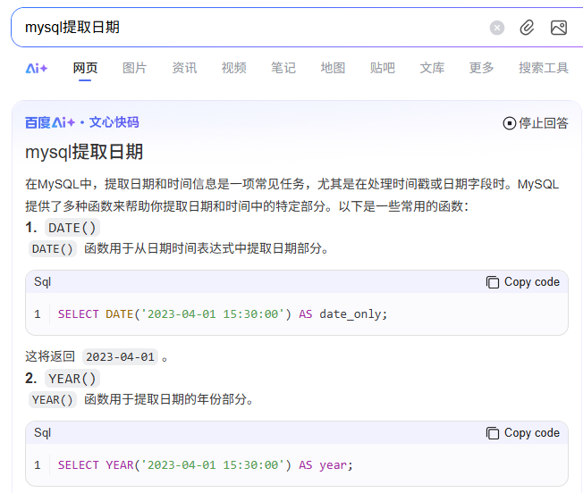
6. Find the customer id of the customers who have made a payment on 2005-05-25 but the amount does not exceed 3.
SELECT DISTINCT CUSTOMER_ID
FROM PAYMENT
WHERE
DATE(PAYMENT_DATE) = '2005-05-25
AND
AMOUNT<=3
Use DISTINCT to remove duplication

